Slide 1
UNUSUAL CASE OF ISOLATED CAROTID ANGITIS
Dr. Sravya kotaru

Slide 2
28/F, Ms. RM presented with :
Left half of the body tingling sensation since last 1 and half months & has been persistent

Slide 3
No history of any radicular pain, weakness, sensory loss, dysarthria or facial asymmetry
No history of headache, vomiting, altered sensorium or seizures
No history of DM/HTN/IHD
No history of skin rash/ joint pain/swelling
K/c/o Hyperthyroidism since last 2 years, non-compliant to treatment
General & Neurological Examination : Normal

Slide 7
DSA : High grade stenosis (Left > Right) at bilateral supra-clinoid ICA

Slide 8
Routine lab investigations : Normal
Hiv/HBsAg/Anti-HCV/VDRL : Negative
ESR : 48
T3/T4/TSH : 1.89/14.06/<0.01
Anti TPO : 100 (Positive)
TSHRab : Negative
ANA by Ifa/ANA Blot/ANCA : Negative
RA Factor : Negative
CSF: Proteins: 71.80mg/dl / Normal glucose and no cells
CSF VZV IgM: Negative
Cryglobulins : Negative
B/L Temporal Artery Doppler : Normal

Slide 9
Patient was started on dual antiplatelets, carbimazole and inderal

Slide 11
Diffuse concentric enhancing vessel wall thickening and reduced caliber of the upper cervical, petrous, cavernous, clinoid and supraclinoid segments of Lt ICA
Mild concentric enhancing vessel wall thickening and reduced caliber of the upper cervical, petrous, cavernous, clinoid and supraclinoid segments of Rt ICA
Findings favour diagnosis of Vasculitis

Slide 12
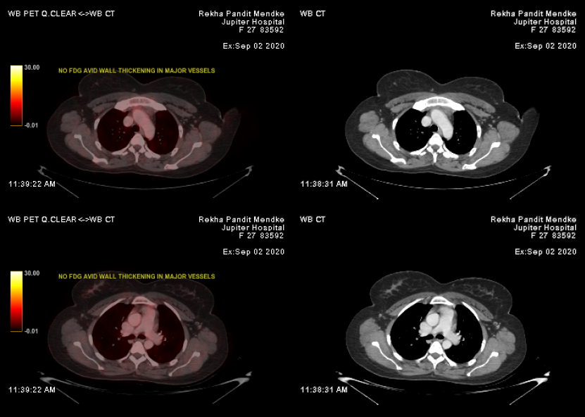
No significantly increased metabolic activity seen in large vessels in mediastinum - to suggest large vessel vasculitis.
No evidence of active disease elsewhere in the present study.

Slide 13
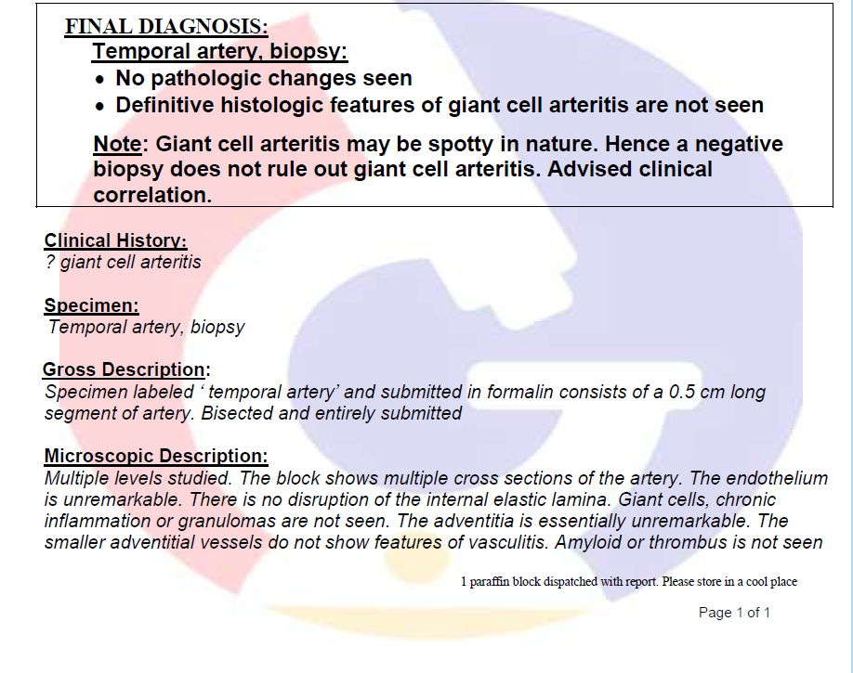

Slide 14
Diagnosis :
Vasculitis of bilateral internal carotid arteries, as a part of early moyamoya vasculopathy with autoimmune hyperthyroidism
Points against :
No distal stenosis and no trans-parenchymal perforators on DSA to suggests moyamoya vasculopathy
2. Isolated Internal Carotid Arteritis with autoimmune hyperthyroidism

Slide 16
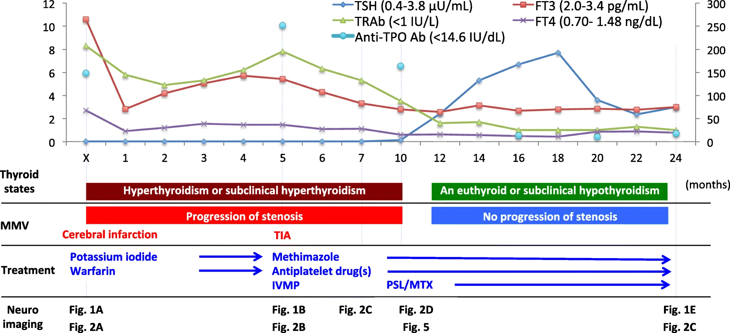

Slide 18
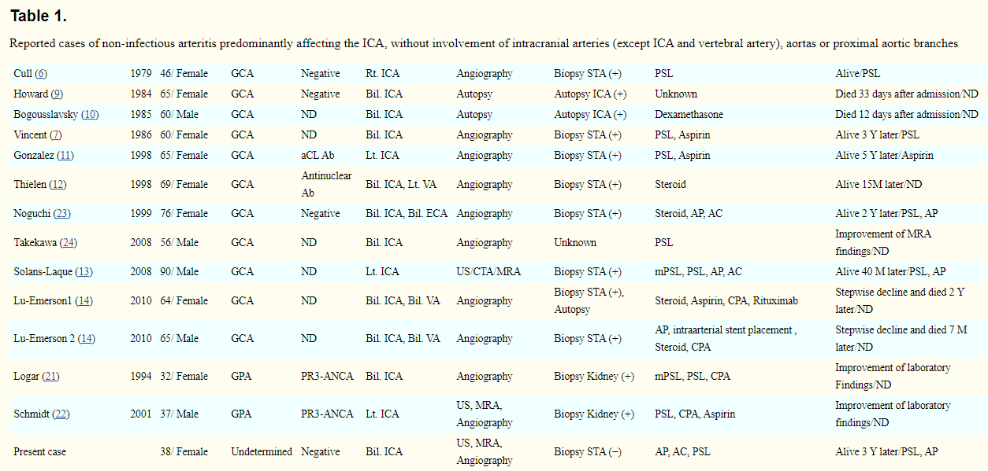

Slide 19
We have treated patient with:
Dual antiplatelet
Carbimazole/Inderal – now in euthyroid state
IVMPS followed by oral steroid
Cyclophosphamide
Patient is asymptomatic

Slide 20
Thank You

